Slide 1


THE
HOPE
COMMUNITY
MANUAL
Notes:
PAYTON
Hi everyone, my name is Payton Gesek. First of all, I’d like to thank Empower Fort Worth for being here…
Introduce the Hope Community Manual and names of group members
We want to provide a resource to organizations that helps them implement burnout prevention into their company’s DNA and let employees know they have the social support needed and belonging to a community.

Slide 2

Target Audience: Organizations employing helping professionals
Prototype: The Hope Community Manual
Notes:
PAYTON
Hospitals, clinics, urgent cares, fire stations, police stations, etc. The Hope Community Manual can be a low-cost way to:
Make helping professionals feel supported
Prevent burnout in helping professionals
Design support groups that are not dependent on one person
Provide optimism to team
Dedra will talk about our interviews with real helping professionals that laid the foundation for our design thinking project

Slide 3
THE REASON
Desiree is a paramedic with Medstar. She describes her typical day at work as dynamic because no day is the same. Paramedics often take their stresses home. It is difficult to ask for help because they are the ones who help others. After the suicide of a loved one in 2016, she started researching peer-support groups that she could implement within her department. After experiencing this tragedy, she realized how important offering mental health and wellness in the workplace is. She did the research, spent the time organizing and getting the approvals to implement The Hope Squad within Medstar.
Brent is the Chaplain for the Fort Worth Fire Department. He is available to help individuals suffering mental/emotional problems, helps coordinate funerals for fellow firefighters, provides resources for those needing medical or mental health providers. There are many constraints with bringing wellness resources into the department due to budgets. Firefighters have demanding schedules, work 24-hour shifts with 48 hours off. They are also paramedics, so they respond to many types of emergencies. The department knows how important it is to have family support. After training, they hold a dinner for all new hires and their families to educate them about the struggles they may face.
Notes:
DEDRA
Both of the helping professionals had to set up their own unique ways to support each other in a budget-friendly way. Both groups experience significant stress at work and feel they should not be the ones asking for help because they are responsible for helping others. After the tragic suicide from someone close to her, she started researching programs that dealt with suicide. She found the hope squad, a peer support group and was able to implement it into Medstar.

Slide 4
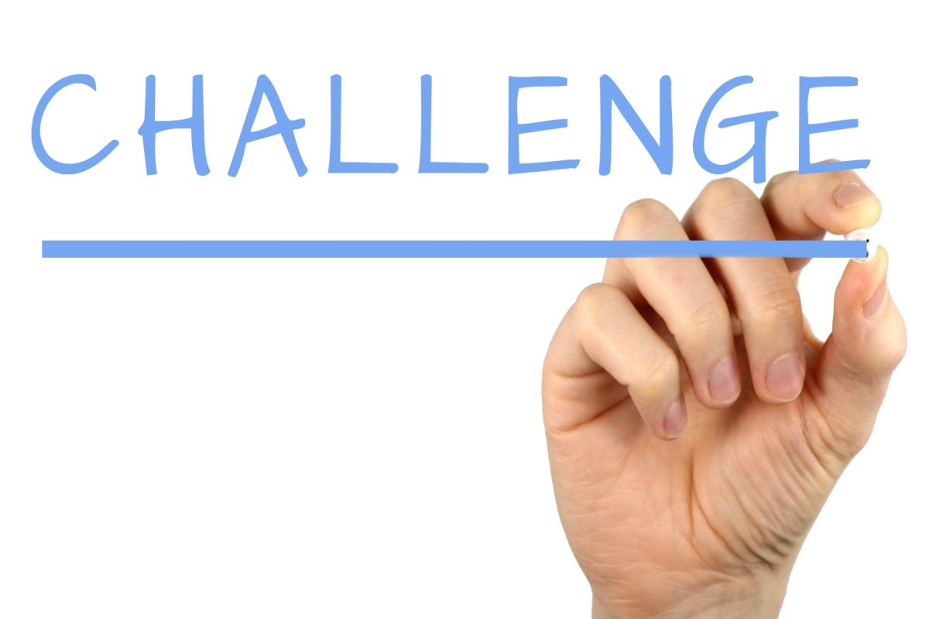
DESIGN CHALLENGE QUESTION
How do we design sustainable support groups to provide hope for healthcare professionals in order to optimize overall wellbeing?
Notes:
DEDRA
Empower Fort Worth Mission Statement: Empower our community helpers by building resilience and promoting awareness of resources to combat the stigma around seeking help. How can other organizations implement a sustainable program that provides hope to their employees?

Slide 5



THE HOPE COMMUNITY MANUAL
This manual has all the resources that are needed to train individuals to become leaders and implement peer-support programs into the workplace.
Can be customized based on employment environment and resources offered to employees.
Allows the program to keep running after employees leave.
Notes:
SUZ
-How to successfully implement the Hope Community to promote well-being among healthcare professionals.
-With a detailed manual, organizations are able to train new hires if needed as well as additional volunteers and workers.
-Valuable insight- creating safe space at work
-Teaches how to detect early signs and symptoms
-Supports all employees
-Reduce turnover rates by improving their wellbeing to reduce burnout;
- also manual is able to help maintain the program after members leave and new ones join.
-Universal and customizable.
-

Slide 6

RESEARCH SHOWS
Work peers understand because they encounter the same situations.
Many people trust their peers more.
Work peers are available immediately after an incident and can help debrief the situation.
Work peers can help the “buy-in” to participation.
Notes:
MARGARET
In a research article by Shanafelt and Sandborg titled Supporting Peer Supporters, they discuss concerning rates regarding anxiety, depression, post-traumatic stress disorder, and burnout, especially after the pandemic.
Evidence reveals that emotional stress and burnout are a common outcome after clinicians have experienced adverse clinical events and that peer support alleviate the risk outcomes.
Peer support is a foundational component of support systems and they quote, “For such programs to be sustainable, it is essential that we care for the peer supporters who provide assistance to colleagues in need.”
-It would be ideal to have it available for all shifts because it allows for peers to vote for who they would like to lead the Hope Community.
-It’s cost effective and can increase retention to prevent burnout, which in turn saves time and money with having to train new/onboarding employees.

Slide 7

WHAT CAN IT DO FOR YOU?
Protect employees from harm by implementing well-being practices and resources.
Help balance work and home life/set boundaries
Promote recognition to employees, let them know they matter.
Opportunity for growth and leadership
Increase retention rates
Notes:
MARGARET
Here are a few ways that you can evaluate the effectiveness of the Hope Community:
-Conduct anonymous surveys that regularly evaluate the effectiveness of the Hope Community Program to make necessary changes and add additional educational resources as needed.
-Collect meaningful feedback from members and continuously track data such as the number of interventions made, and the overall mental wellness of employees in the workplace.
-Some additional resources include mental health first aid training, QPR training that can help save lives and reduce suicide, the NIH emotional wellness checklist, and the US dept of health and human services workplace well being resources
-Be open and mindful when referrals may be necessary. It’s okay to advise and refer to an advanced professional that specializes in that area.

Slide 8
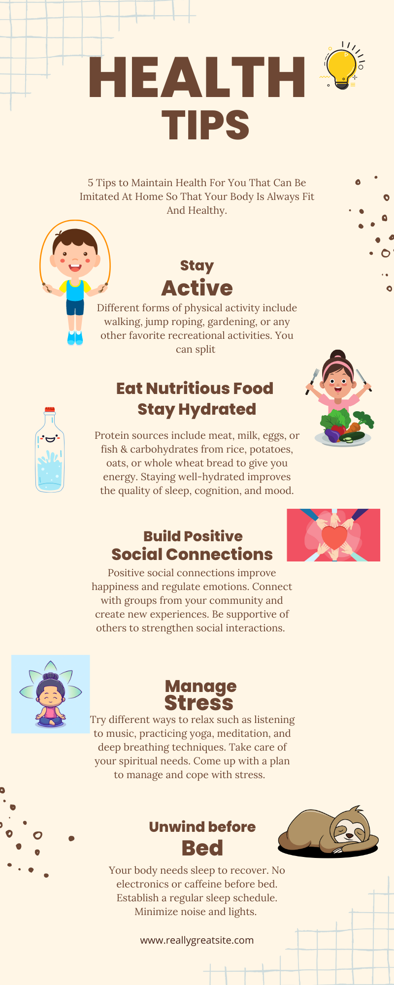
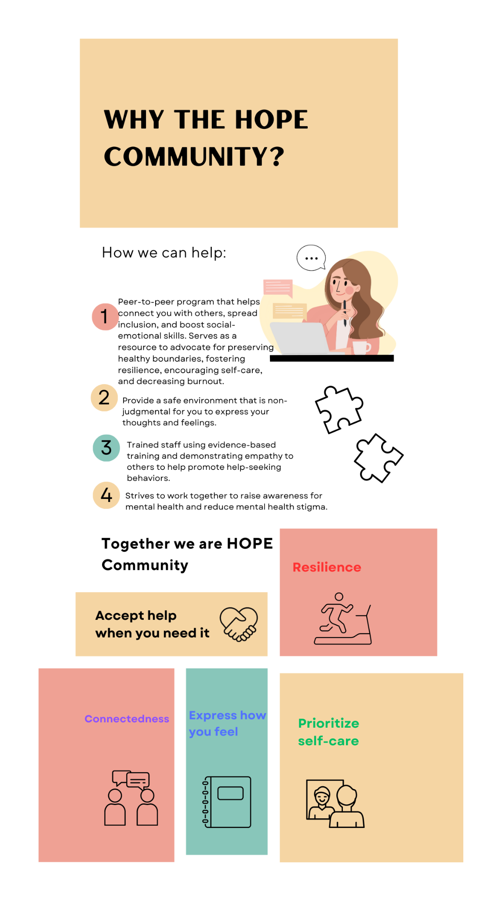
Infographics
Notes:
1 Infographic focuses on 5 health tips to maintain one’s health that can be imitated at home, such as staying active, keeping hydrated/balanced diet, managing stress, and unwinding before bed.
2 infographic - what Hope Community stands for; raise mental health awareness, resource to advocate to preserve healthy boundaries, fosters resilience, encourages self-care, reduce mental health stigma, and reduce burnout.

Slide 9
KEY TAKEAWAYS
Payton
Margaret
Dedra
First Idea ≠ Best Idea Brainstorming
Trust your team members
Research and collaboration
Daisy
Suz
Listening to interviews
Safe space at work
Notes:
DAISY
Payton - My biggest takeaway was that the first idea is not always the best idea. There are ways to brainstorm and and combine ideas to make an even better idea at the end of the session. Sometimes as coaches, we think we know the best route for our clients, but what we really need to do is non-judgmentally brainstorm ideas and see what ideas can be combined to better serve the client’s needs and values.
Margaret - Trust among team members is the foundation of effective teamwork, and just like in coaching, trust takes time to build. It allows for collaboration, and everything else will fail without teamwork. Clients are willing to be challenged if they trust the person coaching them.
Daisy - The biggest takeaway for me was having the opportunity to hear how the interviewees that we [the group] interviewed cope during difficult times. They provided a great deal of information and insight into how they provide assistance for their work environments during challenging times. As a coach, it is important to develop strategies that are most appropriate for clients.
Dedra- My key takeaway was with research and collaboration, we can create a program/prototype that can have a great impact on first responders and healthcare workers. There is a great need for implementing wellness into these fields, but little financial resources are available to get the programs running.
Suz - There’s a significant impact on mental health and well-being, especially in regard to healthcare professionals. It is important to create a safe space that allows for compassion and empathy in the workplace. Implementing a program like this can reduce stigma and increase employee satisfaction, productivity, and reduce turnover. It’s a valuable tool for promoting a healthier and more supportive workplace environment with long-term benefits.

Slide 10
“He who has health has hope, and he who has hope has everything”
Arab Proverb
Notes:
DAISY

