Slide 1
Workplace Wellness
Consulting
Team 2

Slide 2
OUR VISION
WWC was created to provide first responders the opportunity to experience wellness in their lives, through education, resources and tips for wellness, self-care and healing. We do this one person at a time, realizing there is no one-size-fits-all method because each person is unique and irreplaceable. This is what differentiates us from other organizations. We never take anyone for granted and know it is a privilege to have the opportunity to walk alongside a client.

Slide 3




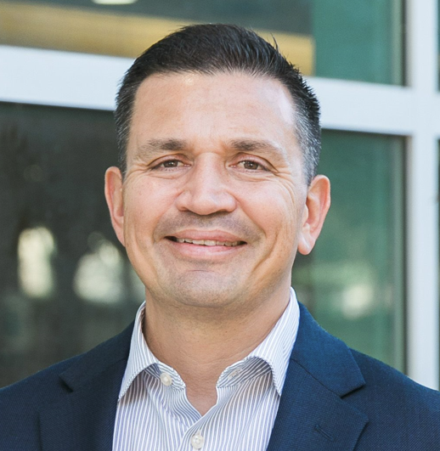
Meet our Team
Sonia
Alicia
​Megan
​Hannah
John Michael
Research
Introductions
Inquiry
Design
Deliverables

Slide 4
overview
One randomized clinical trial proved those who had coaching had a significant reduction in emotional exhaustion, overall symptoms of burnout, improvements in overall quality of life and resilience.
Promoting healthy lifestyles through adequate workplace wellness measures optimized employee’s health and potential for engagement at work.
A meditation program significantly improved caregiver stress, burnout and secondary traumatic stress as well as improvements in feelings of compassion.
Findings from this review underscored the importance of taking a proactive approach to self-care and, in particular, integrating self-care directly into clinical training programs.
Notes:
We reviewed several scientific articles that showed the importance of health & wellness in the workplace, especially for healthcare providers.
Here are a few highlights:
-Wellness programs have a significant reduction in emotional exhaustion, overall symptoms of burnout and improvements of quality of life and resilience.
-Promoting healthy lifestyles optimizes employee health and potential for engagement at work.
-Meditation improves caregiver stress burnout and also improves feelings of compassion.
-Findings underscored the importance of self-care especially when integrating it into clinical training programs.
We want to educate leaders about the importance of giving clinicians time for self-care. Why? Because clinicians are expected to perform under pressure, eat on the go, work odd hours that affects their Circadian rhythm, and still be able to meet the bottom line. This was not just based on reading scientific articles but also in speaking with those who experience this everyday.

Slide 5
PROBLEM STATEMENT
“
How can we change organizational structure to Give back Time to health professionals time so that they experience more well-being?
”
Notes:
Problem Statement
This is the problem that we can address.

Slide 6
AREA OF FOCUS
Giving Back Time
  Investigating Sources Of Time Lost At Work
  Discovering Organizational Needs
  Recommending Solutions For Areas Of Need
  Design Programs To Incorporate Organizational Wellness
  Evaluate Solution Effectiveness
Notes:
Ultimately, we chose to focus on giving back time to our employees by creating WWC. WWC will come in to address, design, and implement programs that decrease time lost at work. Our Prototype is a business model. Our approach is laid out in PowerPoint form for easier review and comprehension. This can be provided at the request of the company. With that being said, here are a few services we will provide:
Investigating Sources Of Time Lost At Work
Discovering Organizational Needs
Recommending Solutions For Areas Of Need
Design Programs To Incorporate Organizational Wellness
Evaluate Solution Effectiveness

Slide 7





The Process
Initial Meeting
ASSESS
DESIGN and Recommend
DELIVER
EVALUATE
Gain an understanding of current concerns and get an idea of desired work
environment/culture
Survey will be distributed to gather needs, goals and desired results.
We will create a customized wellness program based on the survey results.
We will implement the program throughout your company network,
We will evaluate the success of the program based on the agreed upon metrics.
Notes:
We developed a five step process that is designed to align with the goals of our clients. We believe in collaboration and customization and aim to deliver a wellness program that improves the well-being of your employees while increasing productivity.

Slide 8
Initial Meeting
Initial meetings with our clients serve as an opportunity to gain insight of their organizational concerns, methods used previously to address these concerns, and their expectations of the ideal outcome.
Types of questions asked in an initial meeting may be:
What is the end goal of this effort for your organization?
What is the principal reason you desire a consultant?
Who is involved with the decision-making and execution for this effort?
What methods have you previously tried?
How prepared is your organization to make the required changes to manifest this goal?

Slide 9
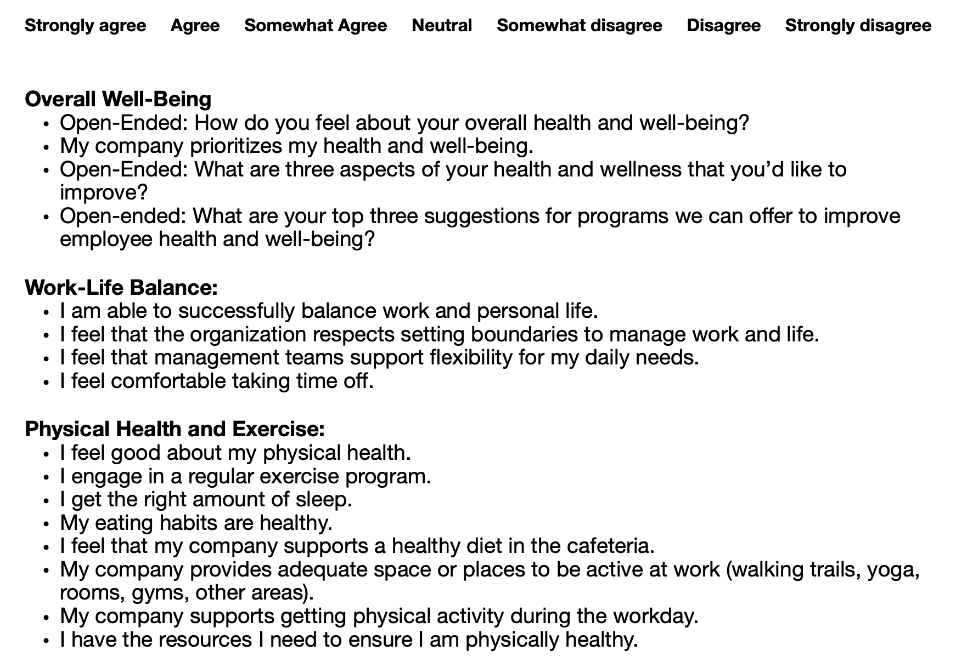
Survey and Analysis
Purpose: to gather data from employees to assess current health and wellness in their specific company
50 question survey distributed to all employees, results interpreted and analyzed
Full Survey Link
Notes:
This slide delves deeper into step two of our overall process. After the initial meeting, a survey will be distributed to all employees (managers included). This will assess the current state of health and wellness in the company. The survey consists of about 50 questions ranging from work/life balance to physical health and exercise. Results are interpreted and analyzed to create a specific wellness program for the company. The blue link at the bottom of the slide will take you to the survey in its entirety.

Slide 10








Recommendations
Assessment
Give you the results
Interpret and explain
Design a Program
Level 1 Implementation
Level 2 Implementation
Level 3 Implementation
Level 4 Implementation
Notes:
So after our survey and analysis, we are able to use the data obtained to best fit your organizational needs. This means that we will be making recommendations and providing solutions to allow more time at work. Here are a few ways we can help: We provide the assessment, Provide Results, Interpret an explain the results , Design a program, and Implement a program.
Ultimately, Our goal is program implementation. If we can create the opportunity for your staff to have more to be present, work productivity and employee life balance can increase.
Program implementation comes in 4 variations with WWC. However, it is important to note that implementation will vary based on organizational needs and each level builds off the previous.
Level 1 : Assessment, Results, Interpretation, and recommendations, but the company implements the program
Level 2:WWC host educational wellness seminars for staff, Wellness committees are outlined , Wellness champions volunteer , Employees work together to create a program that best fits their needs
Level 3: Program Initiation, Outline of Continuation, Employee Wellness Champion Selection, Blueprints for redesigning workplace, Individualized program branding, and Virtual coaching and counseling services
Level 4: Complete Program Management, New Global Benefits package, Redesign Workplace Environment, Staff Education, Rapid Response Mental Health Helpline

Slide 11
Solution Packages
Level 1
Level 2
WWC host educational wellness seminars for staff
Wellness committees are outlined
Wellness champions volunteer
Employees work together to create a program that best fits their needs
Assessment
Interpretation and Recommendations provided
Company uses the knowledge provided to create their own wellness program

Slide 12
Solution Packages
Level 3
Level 4
Complete Program Management
New Global Benefits package and expansion
Virtual Counseling and Wellness Coaching Services
Individualized program branding
Design/Redesign workplace environment
Life after loss and new parent return education
Rapid Response Helpline
Program Initiation
Outline of Continuation
Employee interview and selection for on-site wellness champion
Blueprints for redesigning workplace
Individualized program branding
Virtual coaching and counseling services
Notes:
Note Outsourced/ Contract workers

Slide 13
delivery
collaborate
Define roles
awareness
launch
support
We will review options to implement the package you choose.
We will define the roles of the leadership team and the employees.
We will create the step –by-step plan to educate employees about the program through internal marketing and social media.
We will launch the program either on site or virtually with leadership and the employees.
We will offer ongoing training and support for every employee to help them attain their wellness goals.
Notes:
Deliver slide

Slide 14
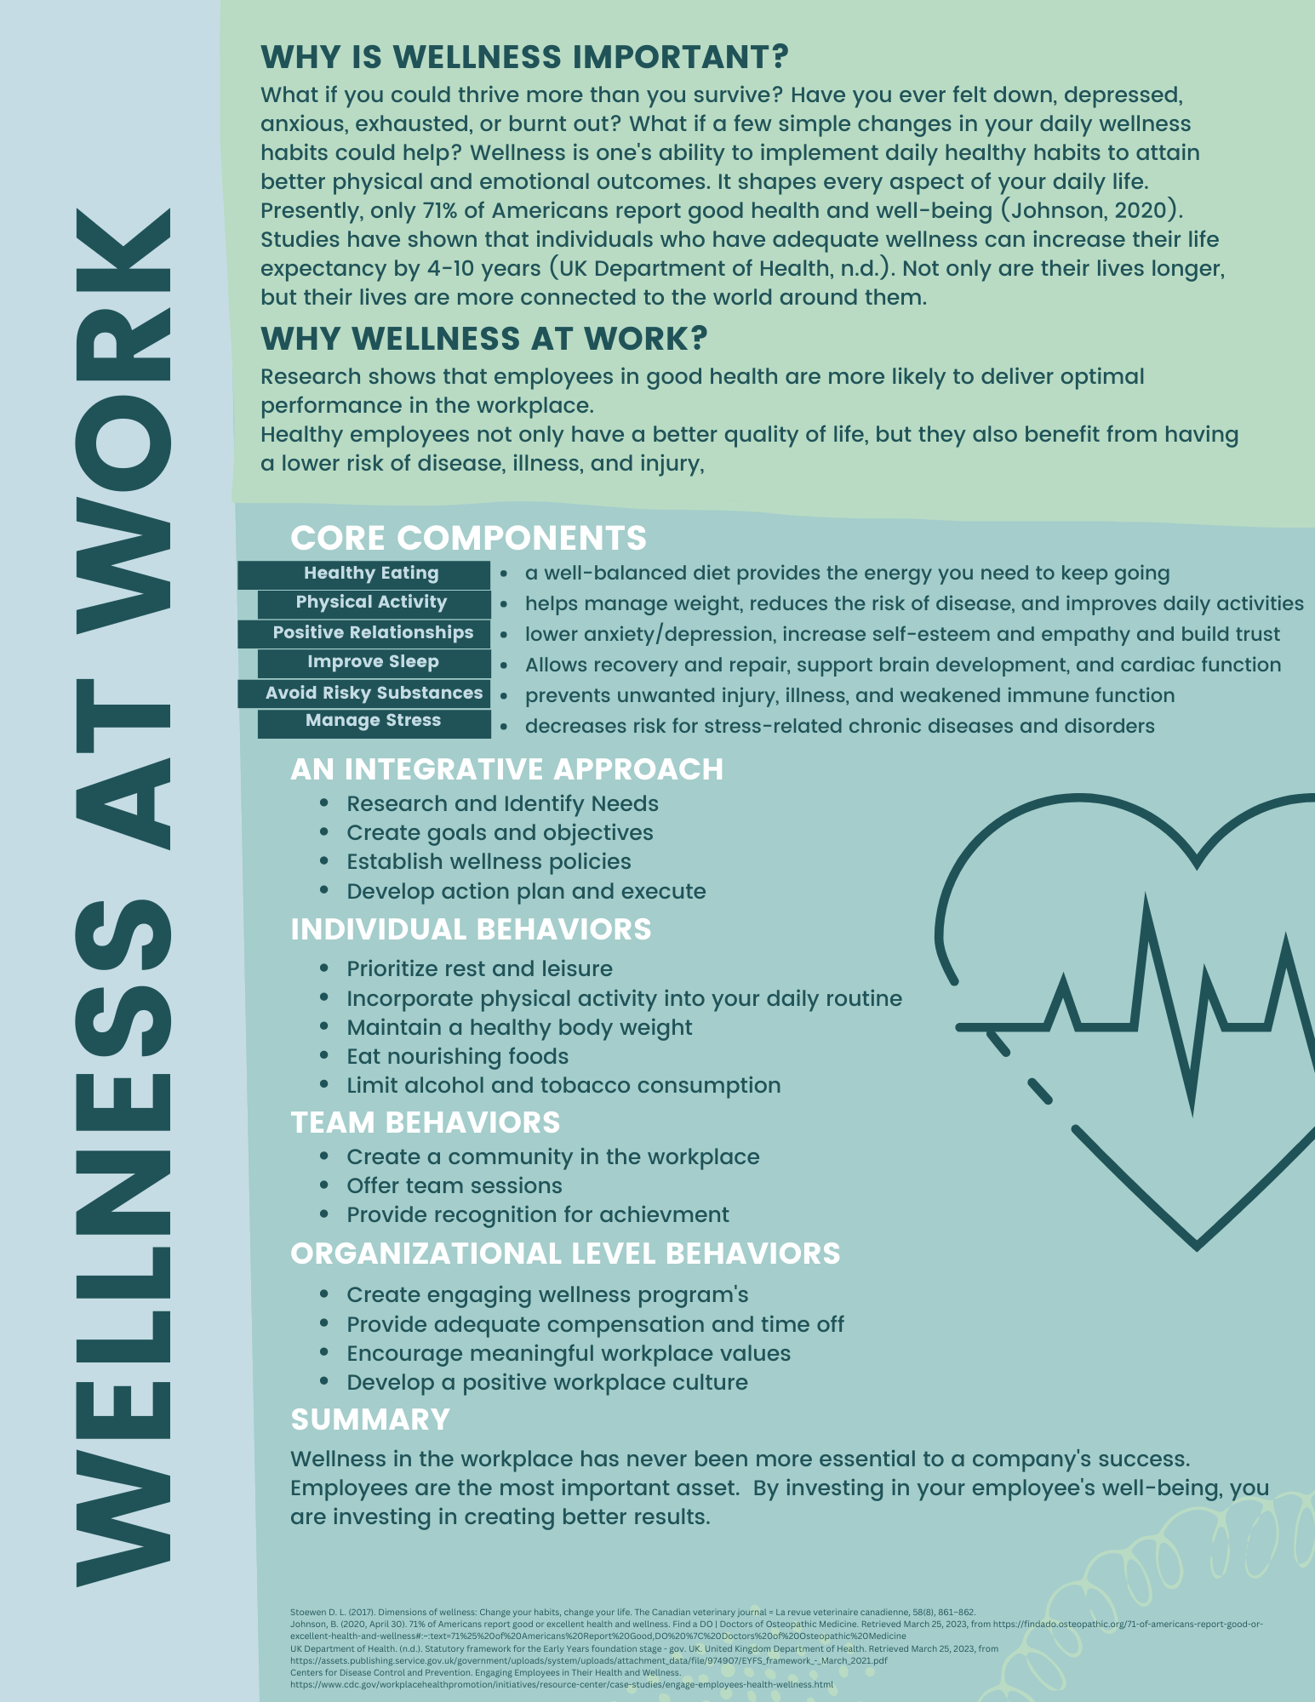

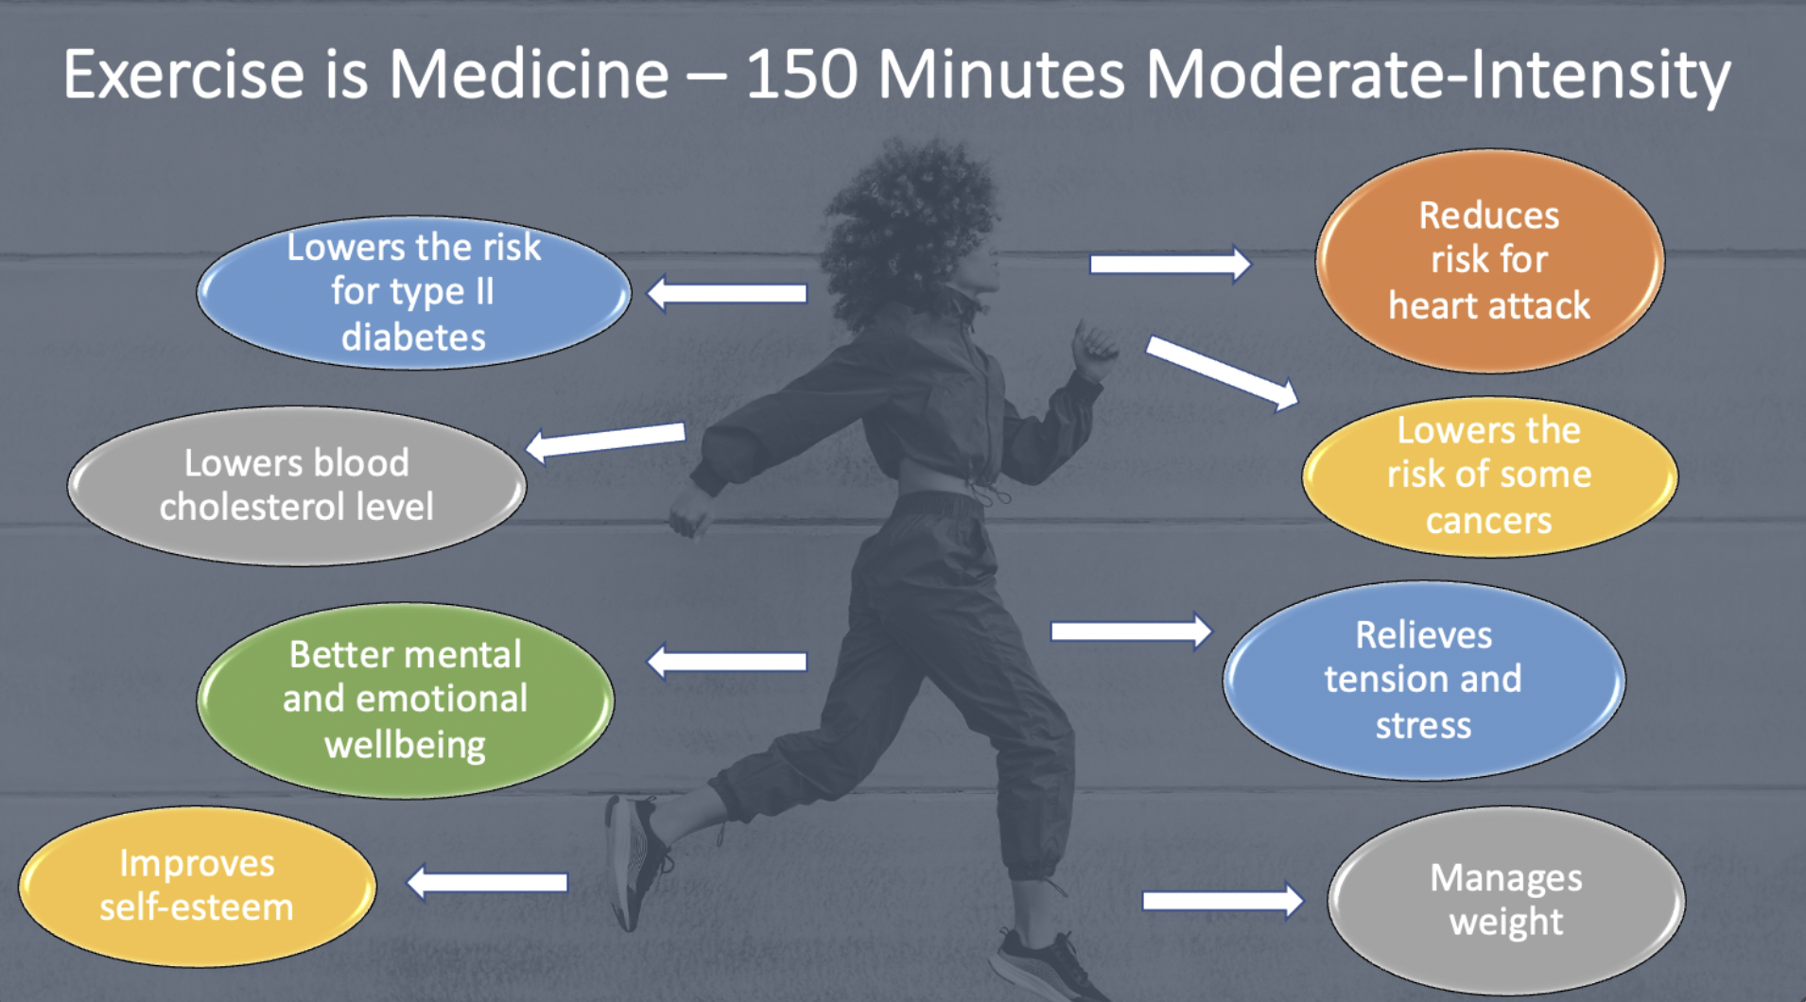
Potential Resources
Notes:
Here we've included 3 examples of resources that could be provided to our client companies: a wellness at work guide and two infographics focusing on stress management and exercise. These were designed for employees to be able to digest and understand information easily in a visually pleasing format. They could be displayed on building walls, distributed to employees, or included in health and wellness meetings. It's up to the company to decide!

Slide 15
Assessing the program
Pilot Group
Halfway through the program
End of the program
Official Rollout
End of 1st month
End of 2nd month
End of 3rd month

Slide 16
Questions assessing the program
Has this program been beneficial? If yes, how? If no, why not?
What has stood out in your mind the most, either good or bad? Why?
What services are you interested in that we didn't provide?

Slide 17

“Improving the health and well-being of our employees makes good business sense. Employees benefit from better support for their health. Companies benefit from less absence and improved productivity. Society benefits from improved public health.”
Steve Flanagan, Commercial Director, Bupa

Slide 18
THANK YOU!
John, Alicia, Megan, Hannah & Sonia
Notes:
Sonia:
We want to thank our professors, Dr. Noah, and Dr. Gillespie for their patience and guidance throughout this process.
Drs. Silk & Norton for introducing us to Design Thinking and pushing us out of our comfort zone.
Dr. Fain and Alissa Schick for their time and candid answers that were the impetus of this project.
Dr. Linde, for her insights about the dynamics involved in health & wellness consulting.
And a special thanks to you, Empower Forth Worth, for giving us this opportunity to share our vision of how to care for those who care for us!
Alicia:
*At this time, we will open the floor for any questions or comments about our findings*

Slide 19
References:
Dyrbye, L. N., Shanafelt, T. D., Gill, P. R., Satele, D. V., & West, C. P. (2019). Effect of a professional coaching intervention on the well-being and distress of physicians. JAMA Internal Medicine, 179(10), 1406–1414. https://doi.org/10.1001/jamainternmed.2019.2425
Qaisar, M. N., Mariam, S., & Ahmad, F. (2018). Employee wellness as predictor of productivity from public sector management perspectives: Conditional process analysis. NUML International Journal of Business & Management, 13(2), 104-116.
Pettus, M., Netter, B., Perlmutter, L., Perlmutter, J. C., & Hosler, A. S. (2022). The effects of mantra-based AMI Meditation on burnout, secondary traumatic stress, and compassion satisfaction levels in healthcare providers. Lifestyle Medicine, 4(1). https://doi.org/10.1002/lim2.72
Posluns, K., & Gall, T. L. (2020). Dear Mental Health Practitioners, Take Care of Yourselves: a Literature Review on Self-Care. International journal for the advancement of counseling, 42(1), 1–20. https://doi.org/10.1007/s10447-019-09382-w

