Slide 1

Empower
Fort Worth
Supporting Helping Professionals Experiencing Emotional Exhaustion and Work-Family Conflict
Holly Fosmark
Kayla Franco
Nadia Sayed
Quinda Feil-Duncan
Notes:
[Presentation Opening - Holly]
Good afternoon, everyone! My name is Holly, and my Design Teammates are Nadia, Kayla, and Quinda. We’ll be sharing our journey through the design thinking process facilitated by Bridge 3 for the benefit of community health workers in Fort Worth.

Slide 2
Community Health Workers
Trusted frontline public health workers with community knowledge who “serve as a link between health and social service programs and the community to promote access to services and improve the quality and cultural competence of service delivery”
(Community Health Workers: Part of the Clinical Care Team, 2020)
Community Health and Social Workers
Therapists & Counselors
Psychologists & Psychiatrists
Other mental health and non-profit workers
Notes:
[Description of CHW demographic; Holly]
The segment of helping professionals we worked with on this project was originally labeled community health workers. By definition, a CHW is a trusted frontline public health worker with community knowledge who “serves as a link between health and social service programs and the community to promote access to services and improve the quality and cultural competence of service delivery”. After conducting our first empathy interview, we realized we needed to broaden the scope of helping professionals included in our research. Ultimately, we addressed issues that impact individuals with a variety of job titles and professions who connect others to services in the community and/or who serve in some capacity in the mental health community. Through our research we heard from CH and social workers, therapist and counselors, psychologists and psychiatrists, and other mental health and non-profit workers.

Slide 3
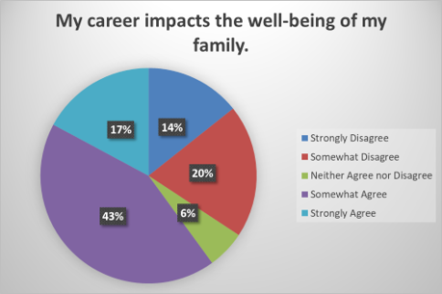
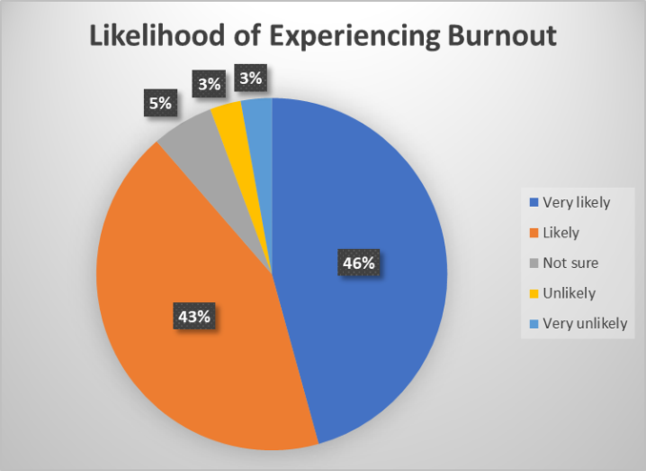
Findings
Survey Data
Empathy Interviews
"We need more meaningful conversations about the hard."
- survey respondent
Notes:
[Holly] - findings
We received survey responses from 35 individuals, the majority of whom are in Fort Worth or the greater DFW area.
60% of respondents somewhat or strongly agree that their career impacts the well-being of their family.
89% of respondents believed it is likely or very likely that individuals in their profession will experience burnout.
Among the top 3 preferences for seeking and receiving health information were professional colleagues and organizations, which is where Empower Fort Worth comes in.
Our empathy interviews and survey data revealed that while some helping professionals in this demographic feel supported in their workplace and are satisfied with their work-life balance, most experience pain points. When asked the question, “What resources, support, or experiences do you wish you/co-workers had that would promote more well-being in your profession?” one respondent stated,
“[We need] more meaningful conversations about the hard. So over all of the “self care” or “avoid burnout “lectures. We all know all of the evidence-based stuff. Information is not the issue. Those generic conversations really just make it worse, as it often feels belittling. The reality is we do hard work, and there often times is not a way around it.”
In an empathy interview, Sarah McDonald, a licensed chemical dependency counselor, explained that she sees a lot of fear and reluctance to seek support among CHWs. She spoke of an experience related to meaningful conversations and support in the workplace that resonates with the pain and longing expressed by the survey respondent. Sarah found community, connection, and a comfortable place to share in participating in monthly meetings of the Spiritual Care Network. The meetings are described as an integration of the spiritual, therapeutic, and recovery communities intended to bring people together and provide opportunities to learn and connect. I’m going to turn it over to Kayla to summarize our findings and the development of our needs statement.

Slide 4

Desire better compensation for the invaluable work they do
Frustrated with complexities and inefficiencies of working with insurance companies
Have awareness of healthy lifestyle habits and self-care practices
Often feel emotionally exhausted despite
loving their work
Want to have emotional energy for family after a day of giving that energy to others
Want peer support through
meaningful conversation with peers
Are seeking a happy medium between self-care and therapy
Finally get client/patient to agree to treatment only to be turned away
Sometimes experience threats to their safety as a result of their work
Seek acknowledgement of the difficult aspects of the work they do
Have stories to tell and need a safe place to tell them
Would like therapy for therapists to be prioritized in their workplaces
Resources exist but are often overwhelmed and/or difficult to access
Often work exhaustive hours resulting in work/life imbalance
Notes:
[Kayla]
Major takeaways
These professionals are normally helping others through their issues or difficulties in life. They are educated and understand what good self-care techniques are and way to destress, as they are usually giving this advice to others. The issue they face is not knowledge-based, but rather social connection and balance. They wake up, see their family quickly before work, go to work and see back-to-back patients, which often times exposes them to vicarious trauma, and then they go home and instantly have to be present for their families. Some feel they are overworked for the pay that they receive. They feel unsupported and are holding onto the traumatic stories and events of others. Often times, the families of these professionals do not fully understand their profession and what they experience. Or maybe the professional does not want to bring the trauma to their partners or children, and then just keep the days issues inside without fully expressing their needs. As previously stated, these professionals know adequate coping skills, but they lack the time in their busy day between high levels of caseloads and balancing family life to actually seek it and proactively take part in self-care and positive coping skills.

Slide 5


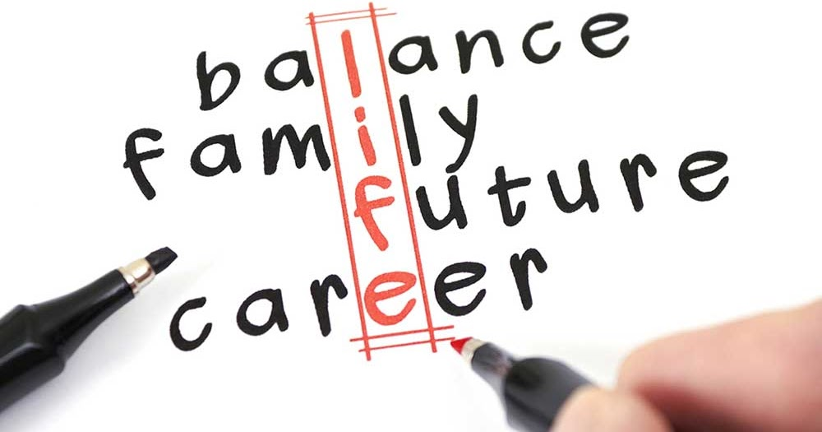
How might we support helping professionals who are experiencing emotional exhaustion and work-family conflict so that they can effectively support their patients/clients, themselves, and their families?
Needs Statement
This Photo by Unknown author is licensed under CC BY-SA-NC.
This Photo by Unknown author is licensed under CC BY-SA.
This Photo by Unknown author is licensed under CC BY.
Notes:
[Kayla]
Based on the data gathered in the DEFINE phase of the design thinking process, we identified emotional exhaustion and work-family conflict as the two most important areas to focus.
why: A combination of high case loads, lack of emphasis on managing job-related stress before the point of emotional exhaustion, over-reliance on self-treatment (expecting people to manage on their own), lack of social support and support from agency/peers/supervisors

Slide 6



Deliverables & Prototype
Peer Support Forum
1
EFW Community Events/Resources Calendar
3
Educational Infographic for Families of Helping Professionals
2
Notes:
[Nadia]
Through our design thinking process, our team ultimately landed on these 3 main ideas for our deliverables that we feel align with our needs statement and could hopefully be realistically achievable ways that EFW can reach community health workers in fort worth.

Slide 7
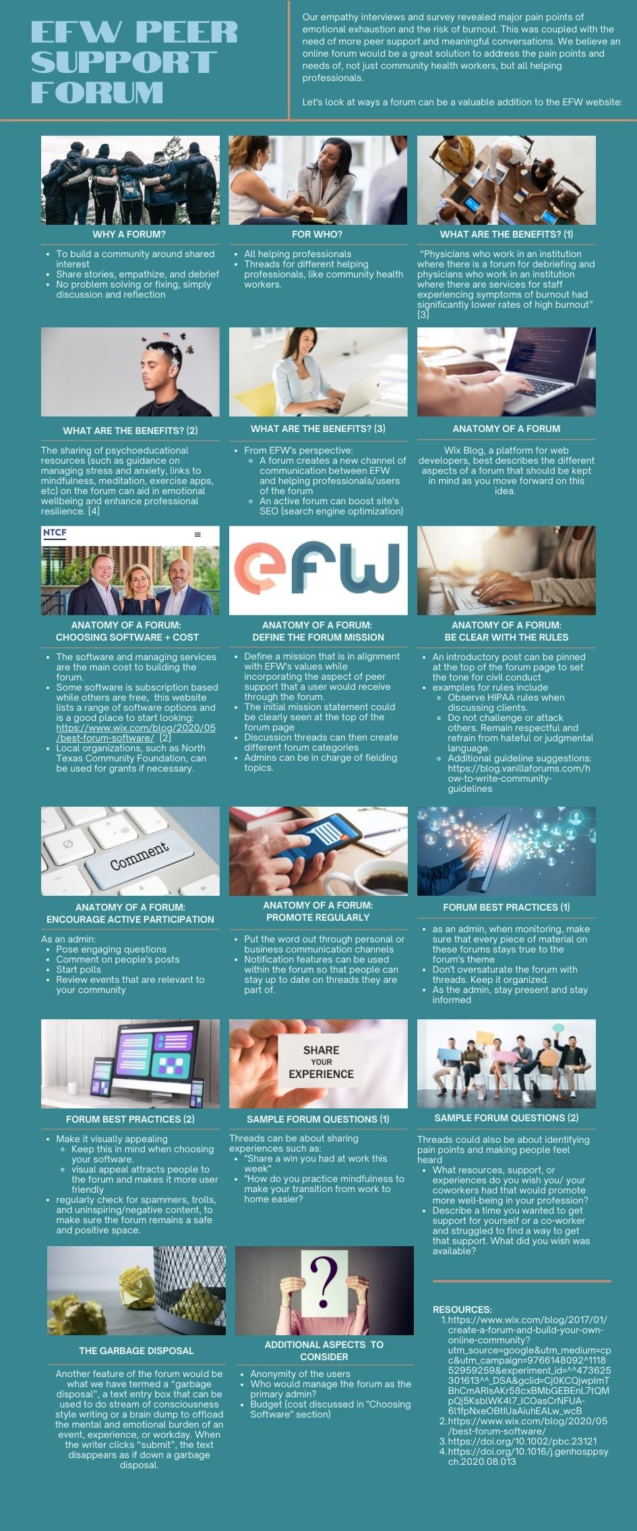
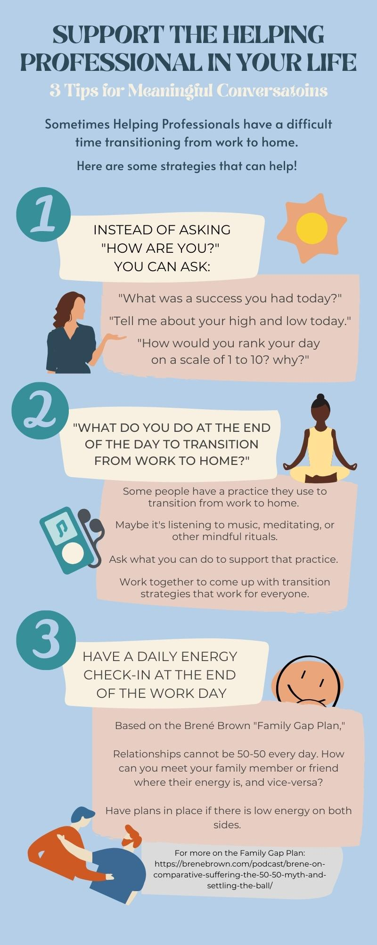
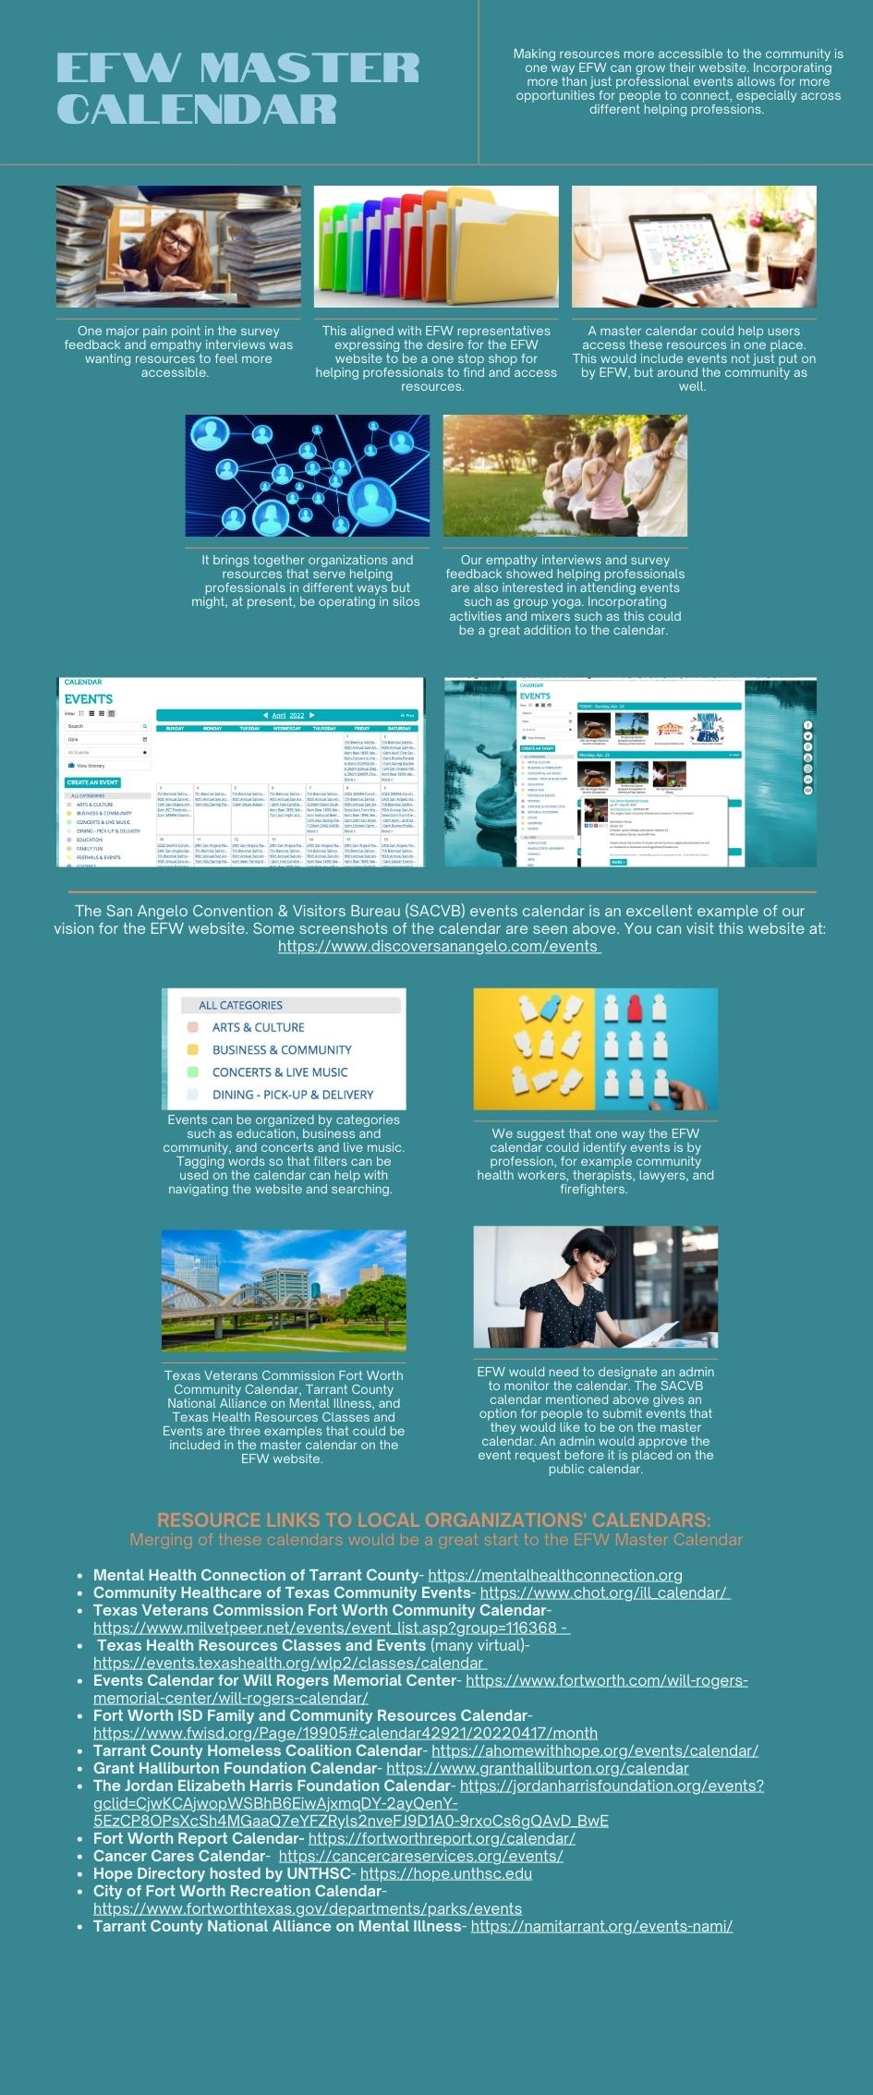
Notes:
Here is a zoomed out view of our deliverables.
First on the left is our prototype for an online peer support forum which we explain through a story board.
Our next deliverable is in the form of an infographic as a resource for the website
And our third idea on the right is for a master calendar for the website. That deliverable gives examples of how to format a master calendar, but most importantly provides a list of local organizations' events pages that if added to the EFW calendar, can be a great step forward to making their website a one-stop-shop for community resources.

Slide 8


Peer Support Forum
WHO – all helping professionals in
the Fort Worth community
WHY - social support increases resilience and reduces burnout
WHAT - to share stories, resources, empathize, reflect, and debrief
PROTOTYPE
Roth et al. (2011) found that “physicians who work in an institution where there is a forum for debriefing... had significantly lower rates of high burnout”
Notes:
[Nadia]
So starting with our prototype,
The idea of an online peer forum was developed based on the major pain points of emotional exhaustion and burnout as well as the need for more peer support and meaningful conversations.
Our research, reflected that the use of social support such as forums and sharing of resources increases resilience and reduces burnout. And as we continued to develop the idea, we believe an online forum would be a great space, not just community health workers, but all helping professionals. Not to mention it gives EFW a channel to reach community members as well.
The mission of this forum is really to create a positive space where community health workers and other helping professionals can have a place to share stories, experiences, empathize, reflect and debrief.
Our story board covers what the benefits of the forum could be, the anatomy of constructing a successful forum, such as software, potential costs, and rules for best forum practices. Ideas that would need future consideration include the budget for software, the anonymity of users, and who would manage the forum as an admin (whether it be an efw member or outsourced).
Examples of potential threads on the forum include "share a win you had at work this week" and "How do you practice mindfulness to make your transition from work to home easier?" It would even be a great place to post helpful resources and encourage communication across different professions.
Although, we know that sometimes people just want to vent, but rather of making a thread of negative comments, another feature of the forum could be what we have termed a “garbage disposal.” Here, people can offload any mental and emotional burden of their day into a text box and when you click submit the text disappears as if down a garbage disposal!

Slide 9
DELIVERABLE #1: Infographic
WHO – family members of helping professionals
WHY – bring awareness to the challenges of transitioning from work to home
WHAT – tips that empower family members to start conversations and offer empathy and support to the helping professionals in their lives
Notes:
[Nadia]
Next, Our infographic addresses the pain point that many helping professionals may have difficulty transitioning from work to home. We liked the idea of an Infographic because it provides simplified but important information in a format that is visually appealing and easy to understand and share. This infographic is aimed towards the friends or families of helping professionals to bring awareness to the challenges of transition from work to home.
It includes 3 strategies for meaningful conversations
Tip 1 gives a few examples of open ended ways to ask how someone is, giving room for more reflective dialogue.
Tip 2 focuses on how to discuss strategies that someone can make to ease the work to home transition. These practices are different for each individual, as we saw from stories in our survey feedback and empathy interviews. For example, in one of our empathy interviews, his strategy was a simple mindful practice of listening for his office door to shut behind him to signify the end of the workday. Another common strategy that we saw through our survey was listening to music at the end of the work day.
The last tip is based off the family gap plan by brene brown and outlines how to check in with someone's energy at the end of the day and suggest to have plans in place if there is low energy on both sides. There is also a link to the helpful podcast where she talks on this at the bottom of the infographic.
Overall we intend for this infographic to provide information to this audience that will empower them to communicate with and support one another to help with the common problem of emotional exhaustion.

Slide 10

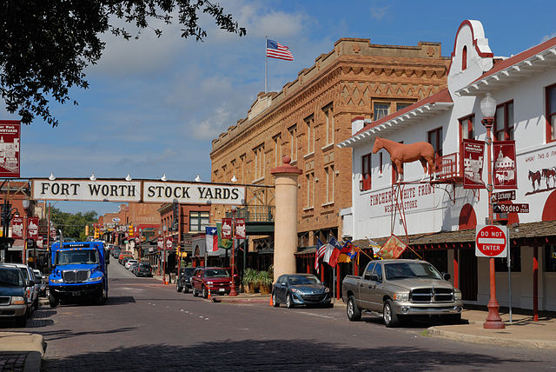
DELIVERABLE #2
Community Calendar Resources
WHO - all helping professionals in the Fort Worth community
WHY - enhance social support for helping professionals; better accessibility and awareness of existing resources
WHAT – a master calendar that includes resources and events from many community partners
Notes:
(Quinda) The concept of a master calendar is to bring together organizations and resources for helping professionals because our data and interviews indicated the need for accessible resource information and many entities currently operate in silos. EFW does have a calendar and we have provided multiple links for EFW to add to their current calendar. Ultimately, having all resources in one place for helping professionals that incorporates more than just professional events can drive traffic to Empower Fort Worth's website. Using examples from other industry websites, we suggest events are organized by categories and tagged keywords that might include professions, events, education and so on. The San Angelo Convention & Visitors Bureau events calendar is an excellent example of our vision for the EFW website.

Slide 11


Design Thinking & Coaching
Key Takeaways
Humans First
Strengths-based (NBI)
CHWs voice
Different Needs & Values
Empathy
Experiment
Embrace the chaos
Generative moments
Brainstorming
Results
Alone vs. together
Notes:
[Holly] Humans First - Helping humans is at the heart of design thinking and coaching. We enter into a coaching session, a design thinking process, or a group project from a strengths based mindset. We started this project with first identifying and valuing the unique thinking preferences of our partners just as Empower Fort Worth believes Community Health Workers and other helping professionals deserve to be heard.
[Nadia] Different Needs and Values - From our empathy interviews, we learned about so many stories, mindfulness strategies, and resources that we otherwise wouldn't have thought about. Which speaks to the benefit of that cross-professional communication. And just like in coaching, we had to practice not assuming or jumping to conclusions and thinking ahead. But rather being present in our interviews and making it about listening, and trusting the process. Also another aspect I found so interesting is that, as we developed our deliverables we found how they can be beneficial and helpful not just for community health members but all helping professionals, which I felt resonates with the empathy rooted in EFW's mission.
[Kayla] Experiment - There were times during this project (and when we are coaching) that things seemed messy and unclear. We had to lean on each other for compassion, humor and nudging to get to the needs statement and that moment we finally knew what the hell we were doing. This is all very much like the generative moment and brainstorming part of coaching. You often do not know where it is going to take you.
[Quinda] Results – In the end, the results we came up with through collaboration look much different (and are better) than what they would have been if we had worked alone on this project. And isn't that why we coach? To provide a space, a process and support to meet a human need better than any of us could do alone? And that is what Empower Fort Worth is striving to do, too. Creating a space for helping professionals so they can continue to do what they do and be able to say, as one of our survey respondents stated, "I love what I do, where I do it, and who I do it with". On that note Onward and Upward

